Slide 1
Matrix Algebra
CHARACTERIZATIONS OF INVERTIBLE MATRICES

Slide 2
THE INVERTIBLE MATRIX THEOREM
Theorem 8: Let A be a square matrix. Then the following statements are equivalent. That is, for a given A, the statements are either all true or all false.
A is an invertible matrix.
A is row equivalent to the identity matrix.
A has n pivot positions.
The equation has only the trivial solution.
The columns of A form a linearly independent set.

Slide 3
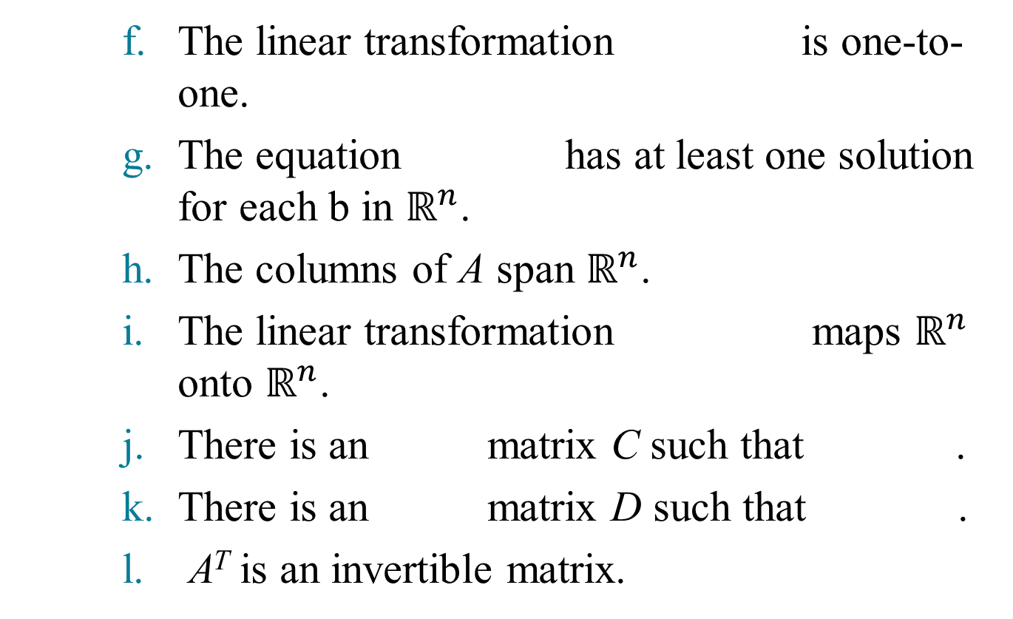
THE INVERTIBLE MATRIX THEOREM
The linear transformation is one-to-one.
The equation has at least one solution for each b in $ℝ^{n}$.
The columns of A span $ℝ^{n}$.
The linear transformation maps $ℝ^{n}$ onto $ℝ^{n}$.
There is an matrix C such that .
There is an matrix D such that .
A^{T} is an invertible matrix.

Slide 4
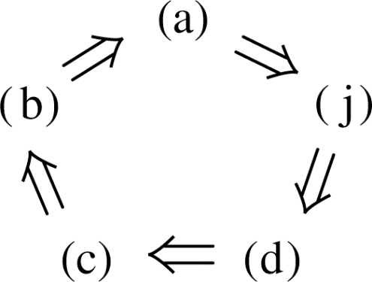
THE INVERTIBLE MATRIX THEOREM
First, we need some notation.
If the truth of statement (a) always implies that statement (j) is true, we say that (a) implies (j) and write .
The proof will establish the “circle” of implications as shown in the following figure.
If any one of these five statements is true, then so are the others.

Slide 5
THE INVERTIBLE MATRIX THEOREM
Finally, the proof will link the remaining statements of the theorem to the statements in this circle.
Proof: If statement (a) is true, then works for C in (j), so .
Next, .
Also, .
If A is square and has n pivot positions, then the pivots must lie on the main diagonal, in which case the reduced echelon form of A is I_{n}.
Thus .
Also, .

Slide 6
THE INVERTIBLE MATRIX THEOREM
This completes the circle in the previous figure.
Next, because works for D.
Also, and .
So (k) and (g) are linked to the circle.
Further, (g), (h), and (i) are equivalent for any matrix.
Thus, (h) and (i) are linked through (g) to the circle.
Since (d) is linked to the circle, so are (e) and (f), because (d), (e), and (f) are all equivalent for any matrix A.
Finally, and .
This completes the proof.

Slide 7
THE INVERTIBLE MATRIX THEOREM
Theorem 8 could also be written as “The equation
has a unique solution for each b in $ℝ^{n}$.”
This statement implies (b) and hence implies that A is invertible.
The following fact follows from Theorem 8.
Let A and B be square matrices. If , then A and B are both invertible, with and .
The Invertible Matrix Theorem divides the set of all
matrices into two disjoint classes: the invertible (nonsingular) matrices, and the noninvertible (singular) matrices.

Slide 8
THE INVERTIBLE MATRIX THEOREM
Each statement in the theorem describes a property of every invertible matrix.
The negation of a statement in the theorem describes a property of every singular matrix.
For instance, an singular matrix is not row equivalent to I_{n}, does not have n pivot position, and has linearly dependent columns.

Slide 9
THE INVERTIBLE MATRIX THEOREM
Example 1: Use the Invertible Matrix Theorem to decide if A is invertible:
Solution:
~
~

Slide 10
THE INVERTIBLE MATRIX THEOREM
So A has three pivot positions and hence is invertible, by the Invertible Matrix Theorem, statement (c).
The Invertible Matrix Theorem applies only to square matrices.
For example, if the columns of a matrix are linearly independent, we cannot use the Invertible Matrix Theorem to conclude anything about the existence or nonexistence of solutions of equation of the form .

Slide 11
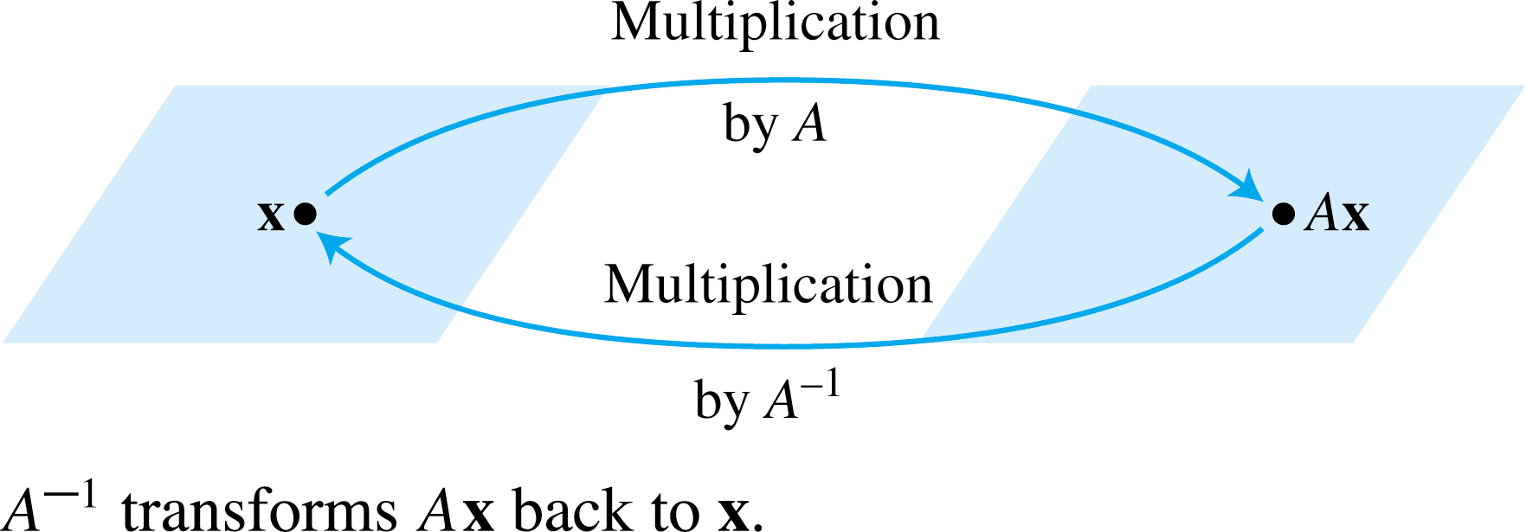
INVERTIBLE LINEAR TRANSFORMATIONS
Matrix multiplication corresponds to composition of linear transformations.
When a matrix A is invertible, the equation can be viewed as a statement about linear transformations. See the following figure.

Slide 12
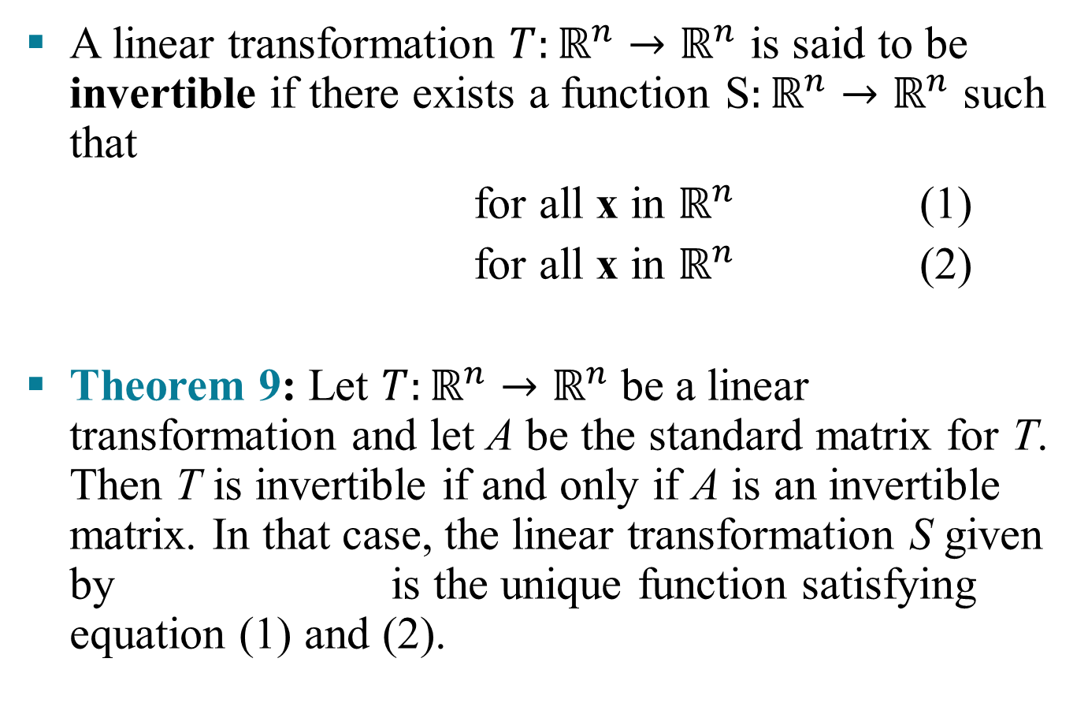
INVERTIBLE LINEAR TRANSFORMATIONS
A linear transformation $T:ℝ^{n}→ℝ^{n}$ is said to be invertible if there exists a function S$:ℝ^{n}→ℝ^{n}$ such that
for all x in $ℝ^{n}$ (1)
for all x in $ℝ^{n}$ (2)
Theorem 9: Let $T:ℝ^{n}→ℝ^{n}$be a linear transformation and let A be the standard matrix for T. Then T is invertible if and only if A is an invertible matrix. In that case, the linear transformation S given by is the unique function satisfying equation (1) and (2).

Slide 13
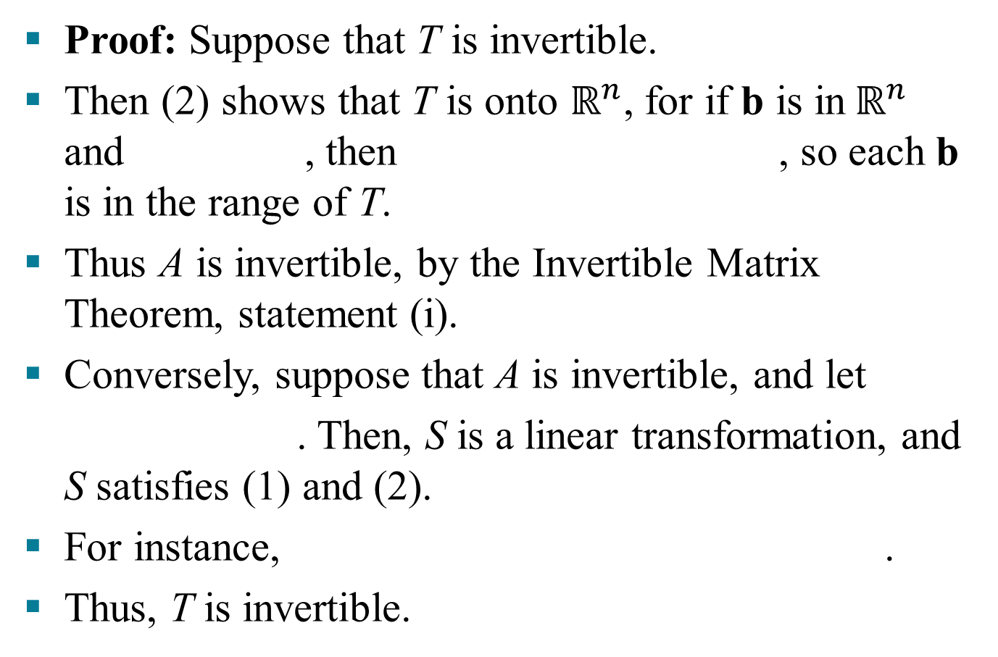
INVERTIBLE LINEAR TRANSFORMATIONS
Proof: Suppose that T is invertible.
Then (2) shows that T is onto $ℝ^{n}$, for if b is in$ℝ^{n}$ and , then , so each b is in the range of T.
Thus A is invertible, by the Invertible Matrix Theorem, statement (i).
Conversely, suppose that A is invertible, and let
. Then, S is a linear transformation, and S satisfies (1) and (2).
For instance, .
Thus, T is invertible.

